Slide 1
Arkansas Work Zones – No Longer Business As Usual
Kenneth Shirley, PE, CCM, DBIA
Construction Management Engineer
ARDOT Transportation Research Conference
August 15, 2019

Slide 2
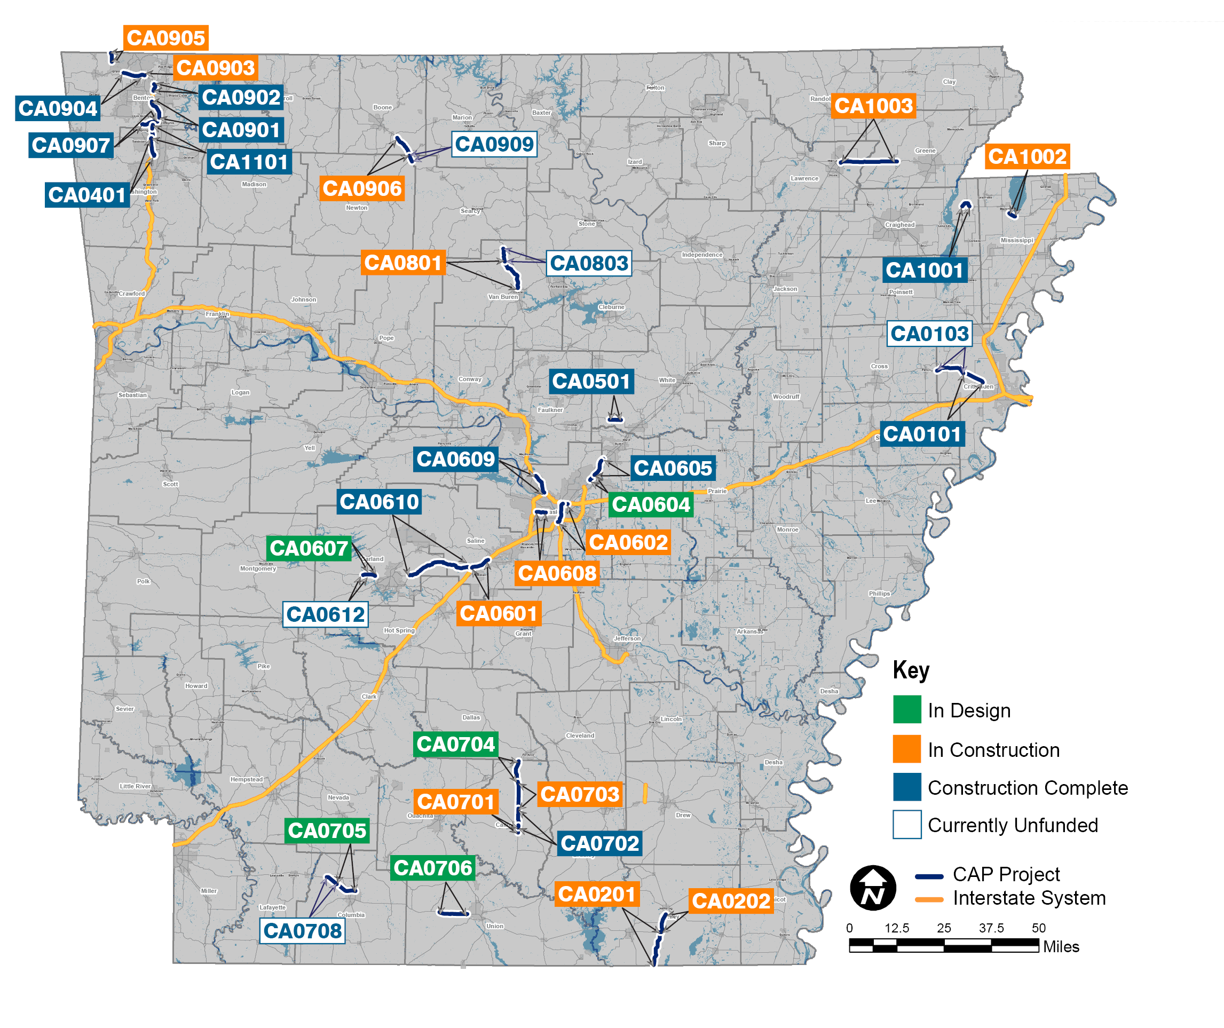
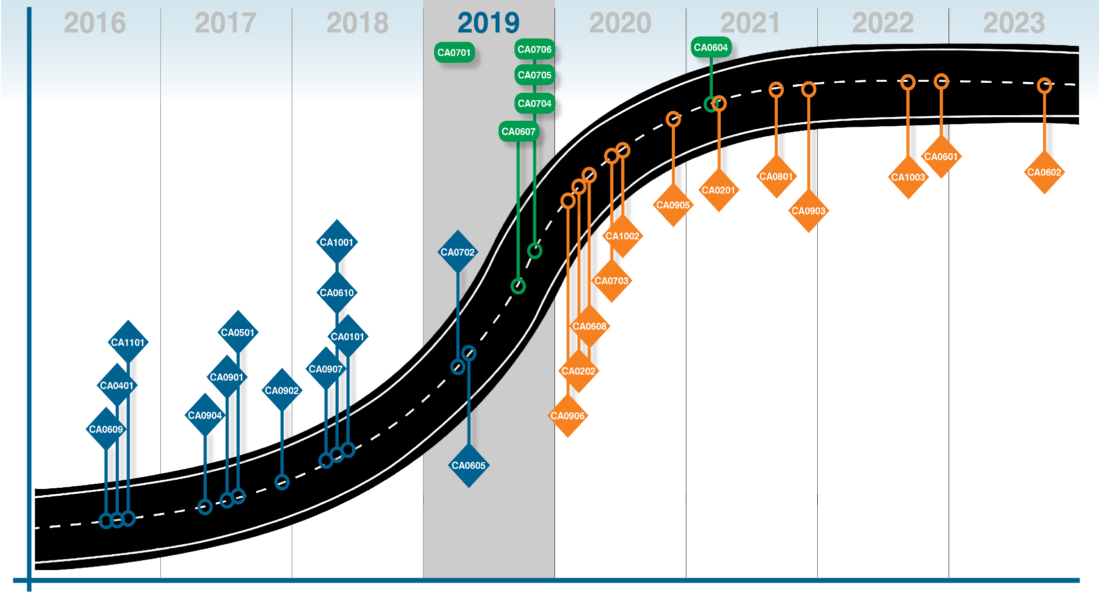

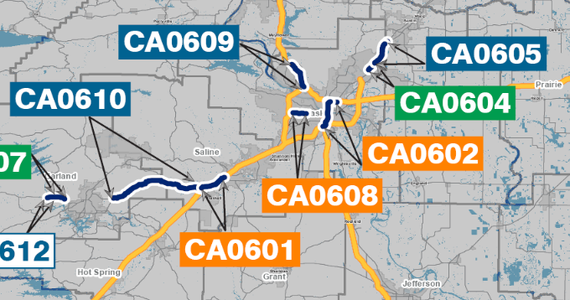

CAP Status of Projects

Slide 3
Job CA0601 - IH 30 : Hwy 70 – Sevier Street
5.4 miles
Widen from 4 lanes to 6 lanes
Reconstruction of Saline River and Saline River Relief bridges
Interchange reconstruction of Hwy 70, Hwy 67/229 and South St
81,000 Average Daily Traffic
$77,000 Daily Road User Cost

Slide 4
Job CA0608 - IH 630 : Baptist Hospital – University Avenue
2.5 miles
Widen from 6 lanes to 8 lanes
Reconstruction of Rock Creek and Rodney Parham bridges
Hughes Street Overpass reconstruction
116,000 Average Daily Traffic
$198,800 Daily Road User Cost

Slide 5
Road User Cost
The additional cost borne by motorists and the community at-large as a result of work zone activity.

Slide 6
Elements of our New “Business Model”
AWIS (Automated Workzone Information System)
Oversize Load and Emergency Routes
iDrive Work Zone Portable Cameras
MAP (Motorist Assistance Patrol)
Wrecker Services
Regular Presence – ASP and AHP

Slide 7
Automated Workzone Information System
Speed Detectors
Variable Message Boards
HAR (Highway Advisory Radio – AM station)

Slide 8
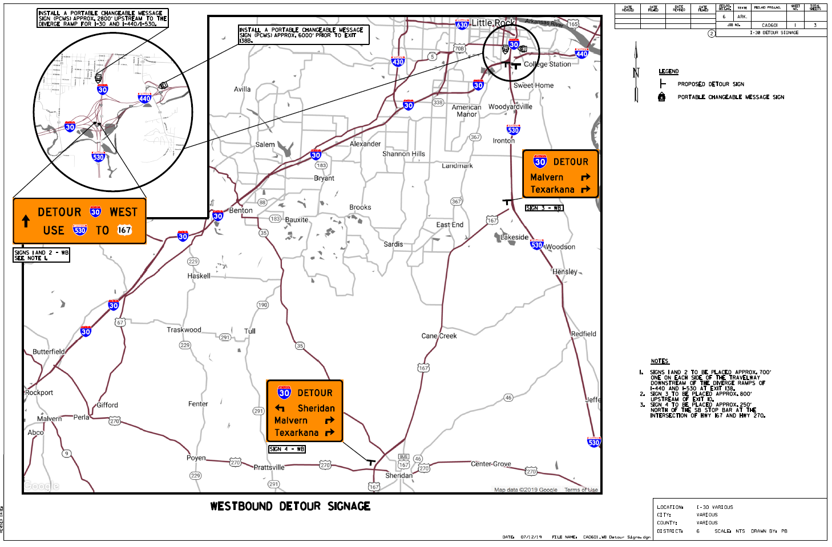
Oversize Load and Emergency Routes

Slide 9
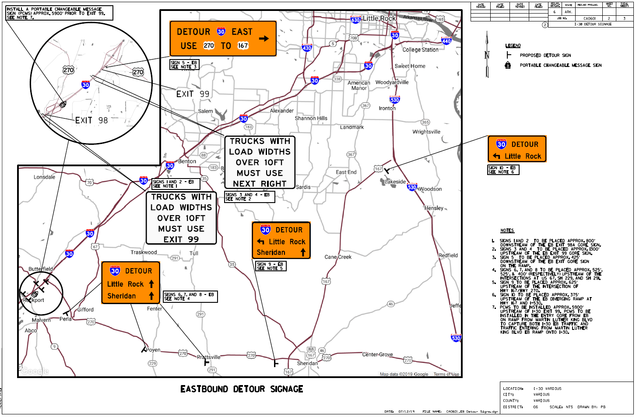
Oversize Load and Emergency Routes

Slide 10
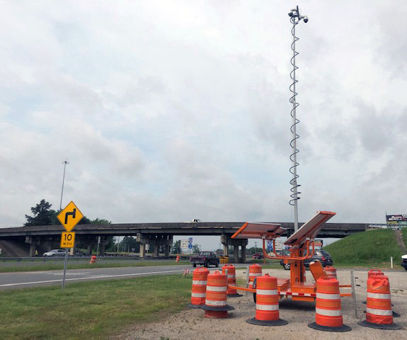
IDrive Work Zone Cameras
CA0608
  4 cameras installed and active
  Located at a major interchange and an overpass
  Hughes Street location provided view of bridge demo and construction

Slide 11
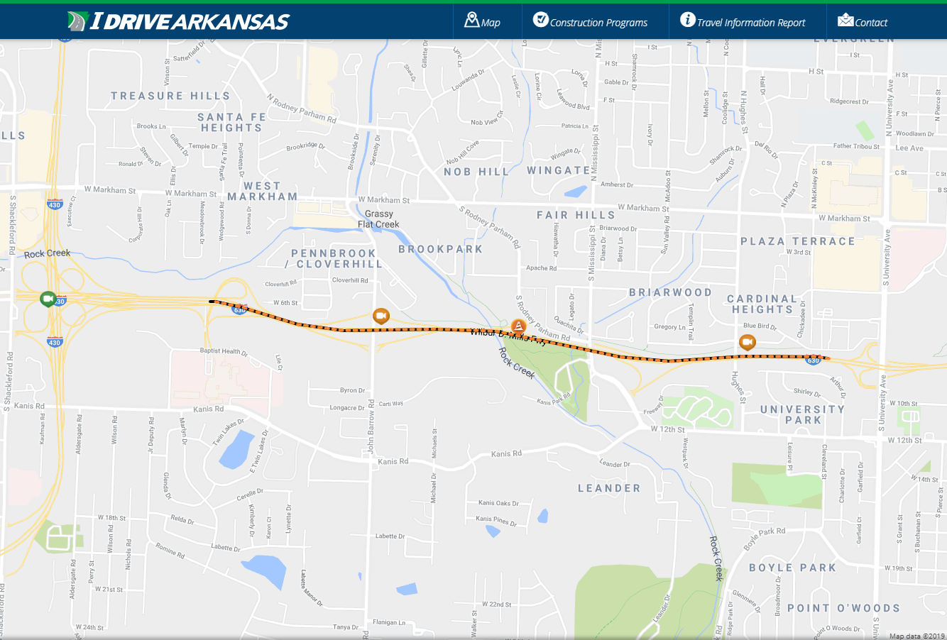
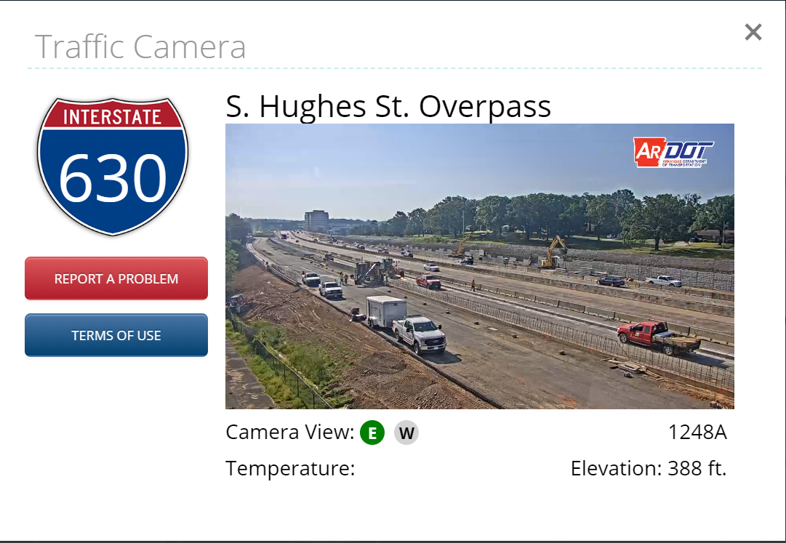
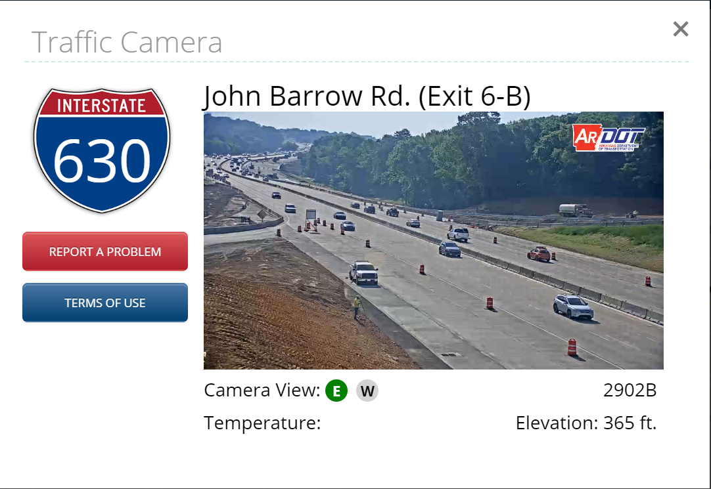
IDrive Work Zone Cameras (CA0608)

Slide 12
IDrive Work Zone Cameras
CA0601
  20 cameras installed
  Located on successive high points
  Little to no “blind spots” within 5.5-mile construction zone

Slide 13
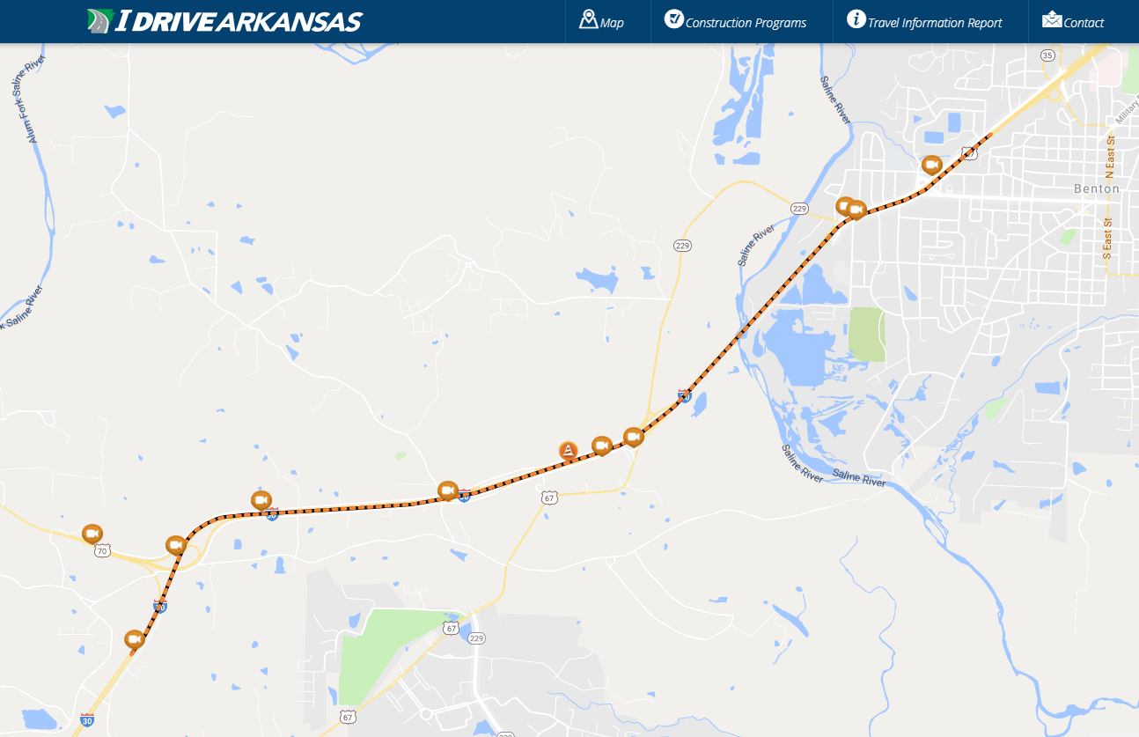
IDrive Work Zone Cameras (CA0601)

Slide 14
Benefits ?
Monitor High Profile Progress
Incident Management
Weather Response
Convenient

Slide 15
Work Zone Cameras – Monitor Progress

Slide 16
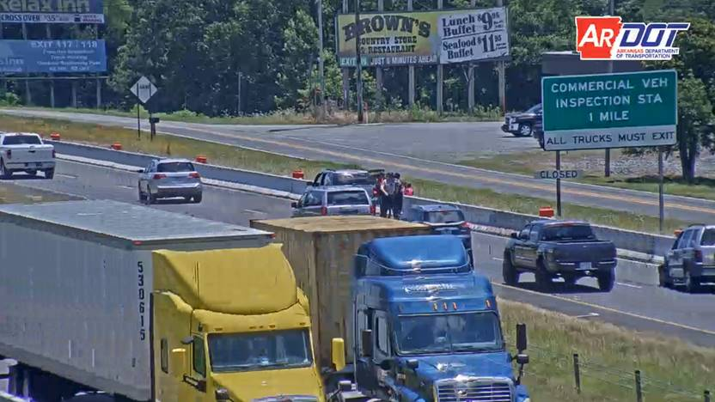
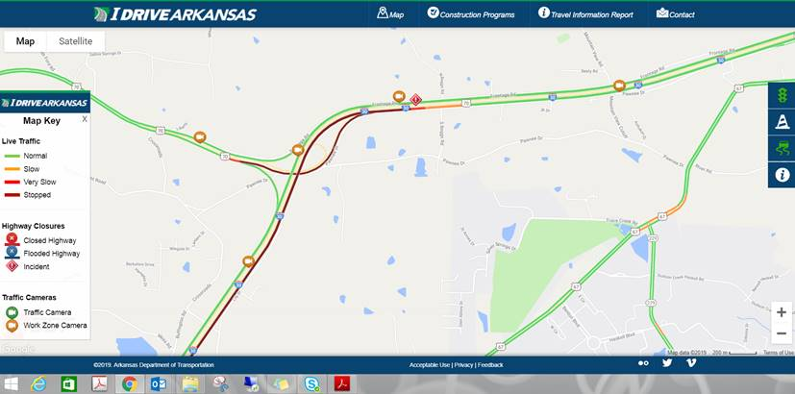
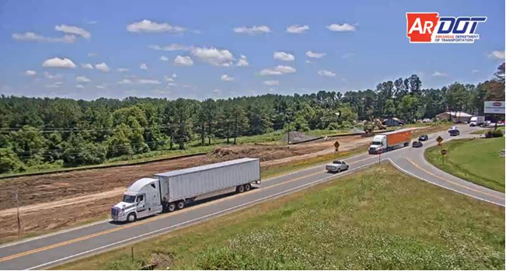
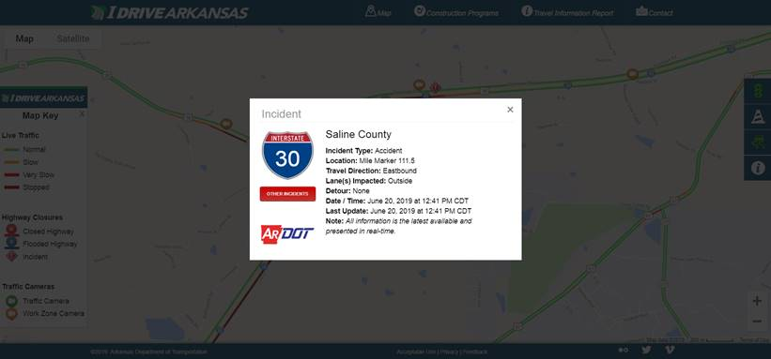
Work Zone Cameras - Incident Management

Slide 17
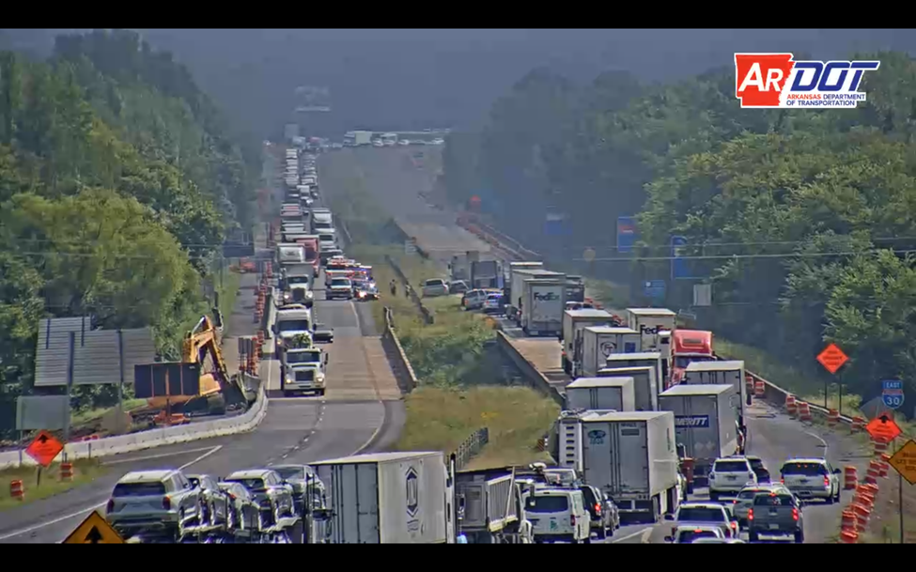
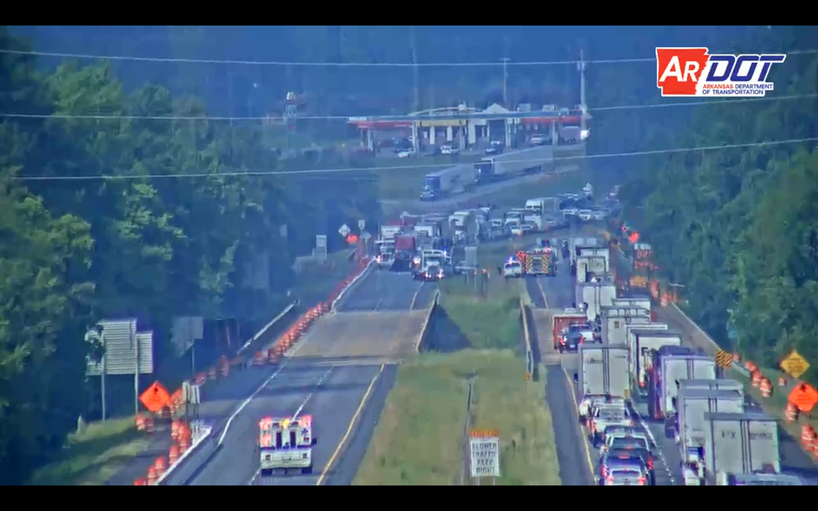
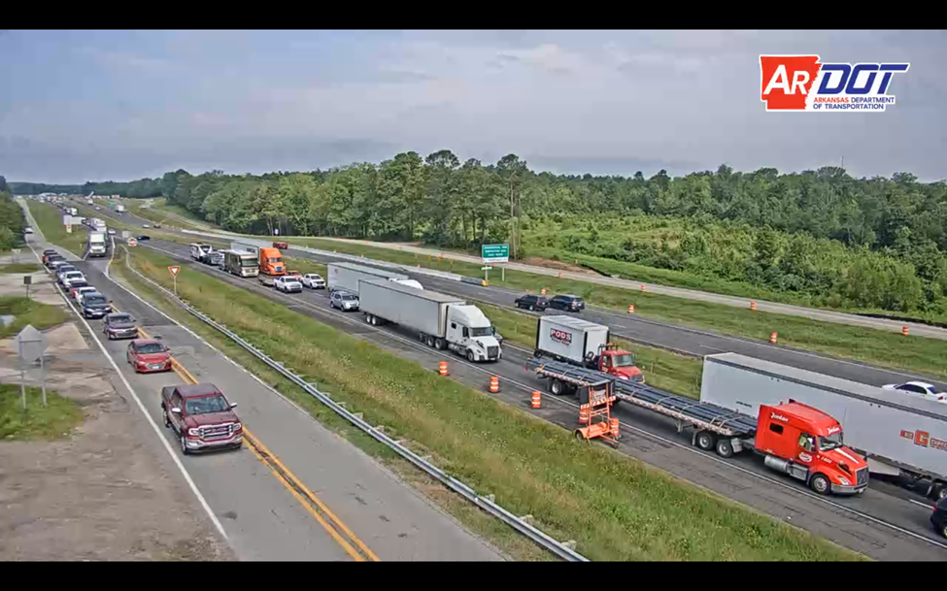
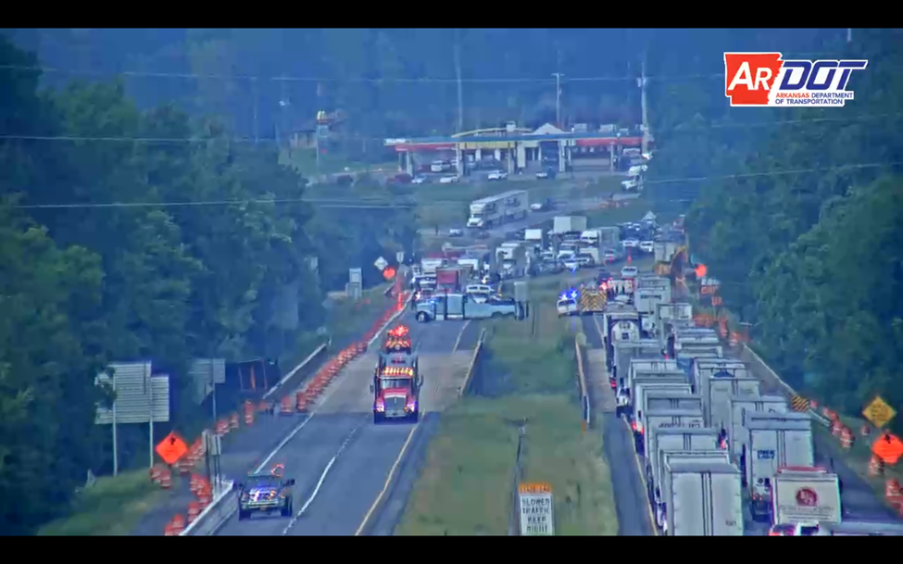
Work Zone Cameras - Incident Management

Slide 18
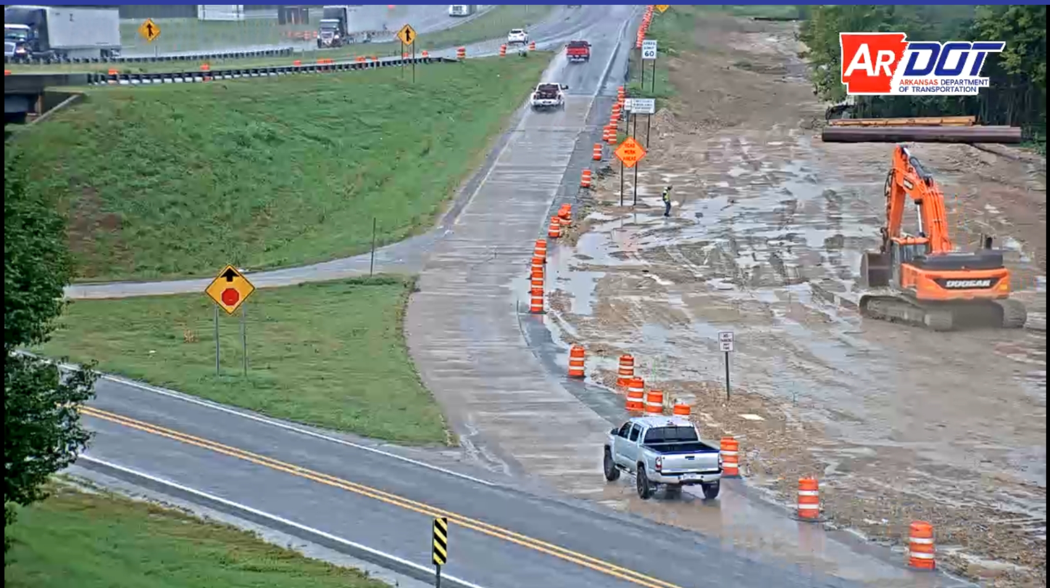
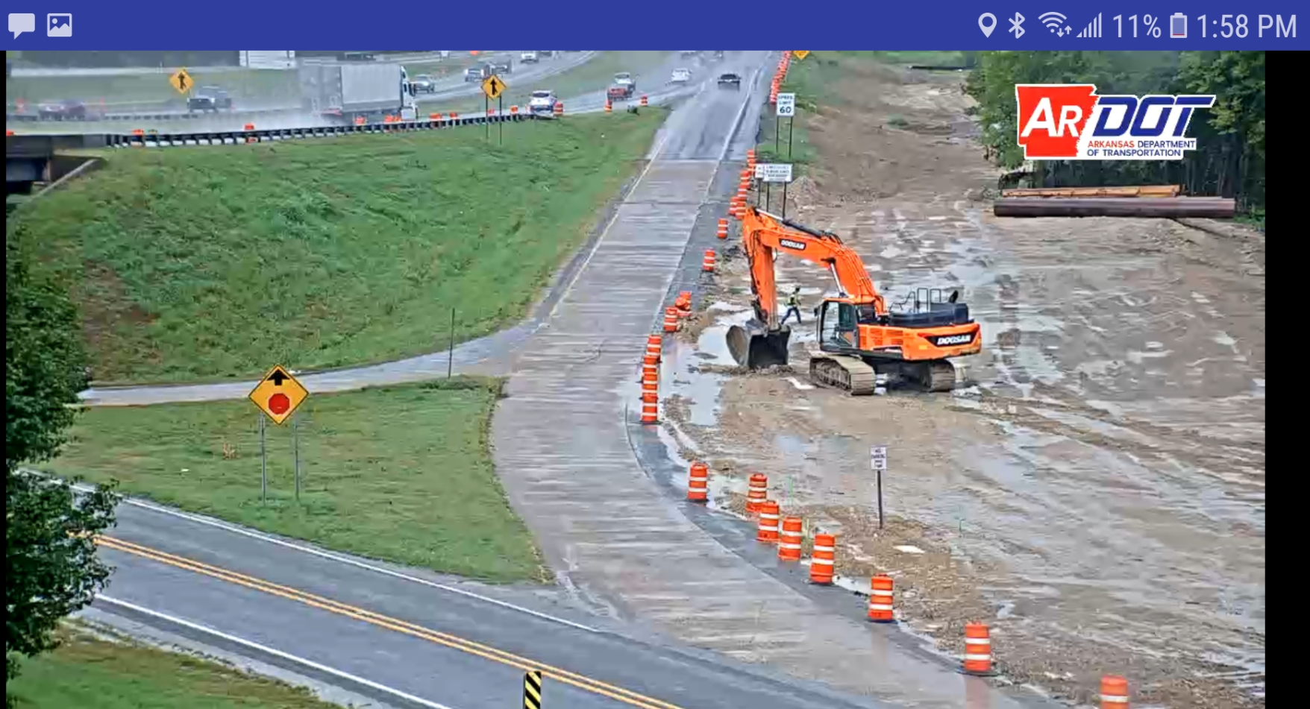
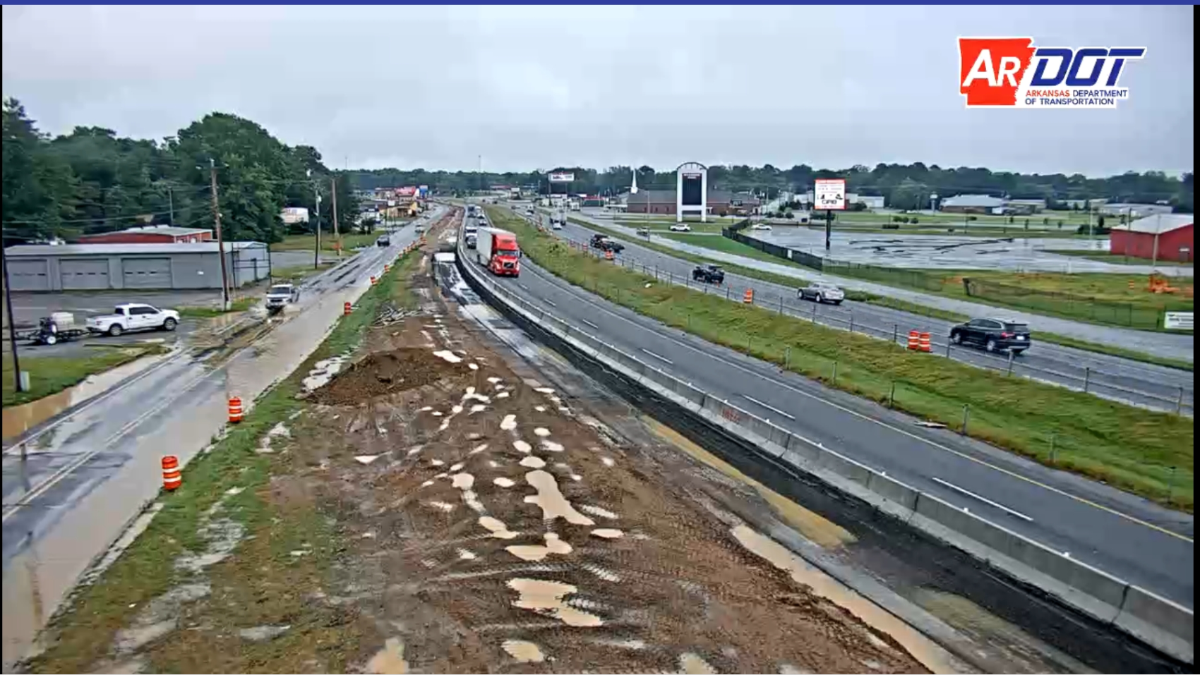
Work Zone Cameras – Weather Response

Slide 19

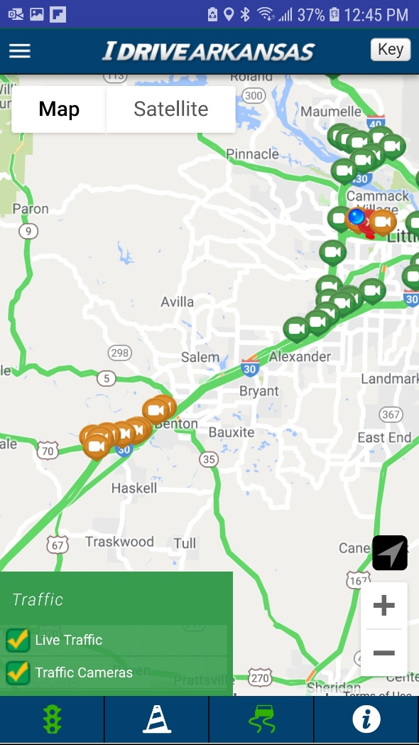
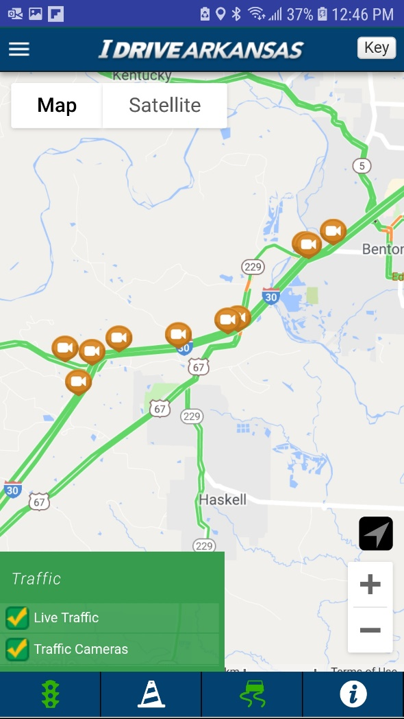
Work Zone Cameras – Convenient

Slide 20
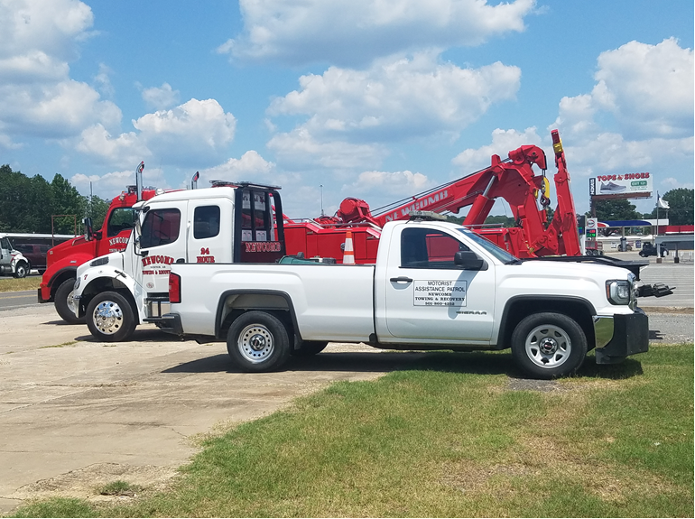
Motorist Assistance Patrol (MAP Truck)
Contractor-provided service
Continuous patrol during
lane closures
Continuous patrol M-F between
6:00am and 8:00pm (CA0601)
Disabled vehicle assistance
  Two gallons of fuel
  Flat tires
  Radiator water
  Jump start batteries and tape hoses
  Move out of travel lanes and onto shoulder
  Initiate wrecker service to clear travel lanes

Slide 21
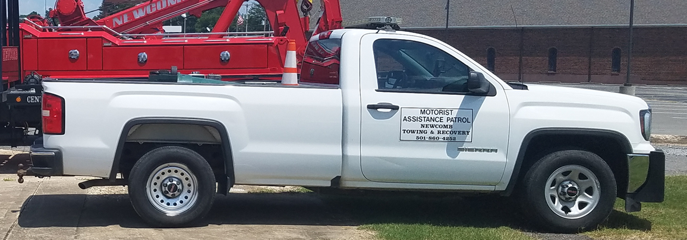
Motorist Assistance Patrol (MAP Truck)
Assist local public agencies and
law enforcement as requested
  Protect scene of accident
  Cleanup minor debris resulting
  from an accident
  Call law enforcement in the event of
  an accident
Department-supplied card explaining services
  Free of charge
  Postage-paid survey card

Slide 22
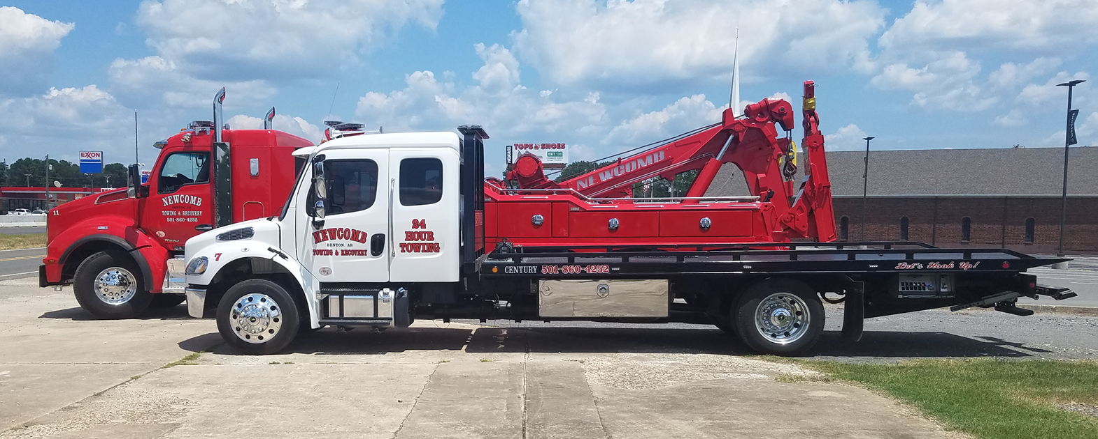
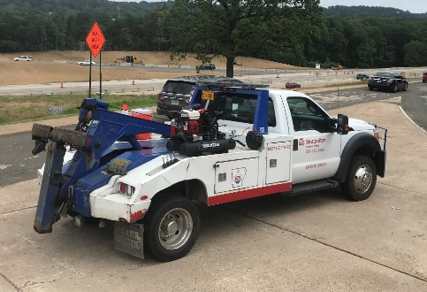
Wrecker Service
24/7 Wrecker Service
  Remove stalled, disabled, wrecked
  or otherwise incapacitated vehicles
  Move vehicles to nearby
  staging areas
  Available within 10 minutes or less
Capable of towing 17,000 lbs (large trucks, tractor trailers, etc.)
Dedicated to construction job
Optional – additional light-duty truck
Accident removals after authorization

Slide 23
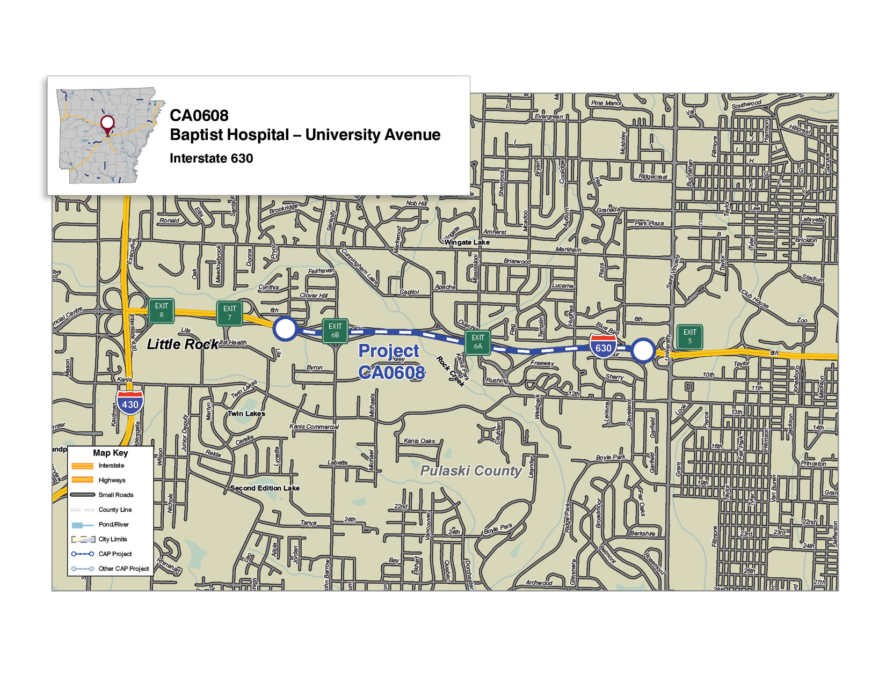

Wrecker Service Staging Areas (CA0608)
I-430/I-630
Commuter Lot
University Ave.
Commuter Lot

Slide 24
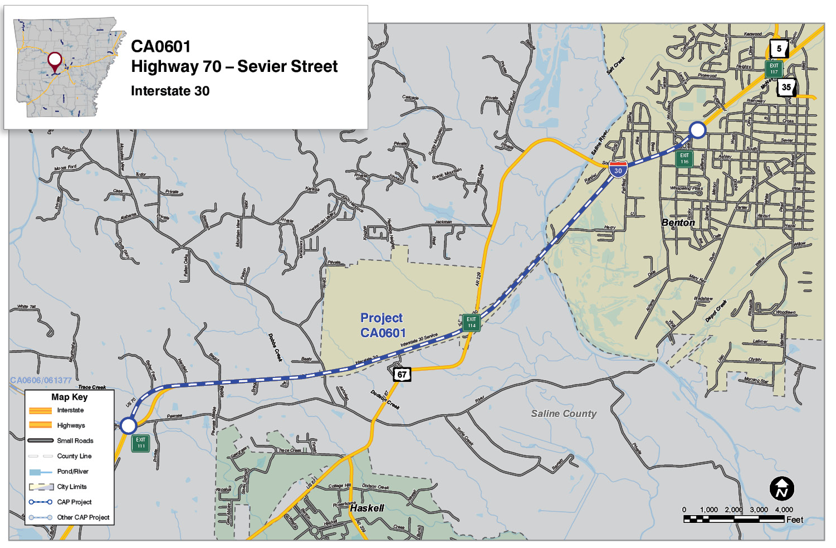
Wrecker Service Staging Areas (CA0601)
Two Sites at Co. Fairgrounds:
Big Rigs and Smaller Vehicles
Two Sites at I-30 Inspection Stations: EB and WB

Slide 25








Jan-April, 2019 (CA0608)
Moved Vehicle From Travel Lane
MAP Services Provided
Blocked Lane / Traffic Control
137 incidents
Jumper Cables
5
69% non-accidents
Fuel
Removed Debris
17
Tire
22
23
28
31

Slide 26


May-July, 2019 (CA0601)
MAP Services Provided
294 incidents
Jumper Cables
3
95% non-accidents
Fuel / Fluids
13
Tire
Relocated Vehicle
Offered Assistance / None Needed
Called Wrecker
14
18
39
155

Slide 27

Do You Need Assistance?
Reasons For Stopping (CA0601)
58
53
Flat Tire
“Under the Hood” Issues
25
19
Resting / Sleeping
14
10
On the Phone
Securing Load
9-1
Out of Gas
Misc

Slide 28
What does the traveling public think of it?
Survey Card Responses
Statistical Comparison with and without MAP/Wrecker Services

Slide 29




28
Survey Cards (57 Received)
Comments
  “I couldn’t reach a friend with a gas can. He literally saved the day!” [Out of Fuel]
  “I didn’t know there was such a service as this. Put it on the
  tv commercials to let people know.” [Mechanical Breakdown]
  “Thank you! This simple gesture may have been life-saving. I had my 95-year-old mother with me who is a stroke victim and on the way to an appointment.” [Out of Fuel]
  “I would love to meet them later and share how they
  probably saved my life.” [Flat Tire]
Flat Tire
13
Mechanical
10
5
Crash
Out of Fuel

Slide 30
Survey Cards (57 Received)
57
0
100%
Comments
  “Was extremely grateful for their help. They helped me get back to Arkansas Children’s Hospital at my daughter’s side very quickly.” [Flat Tire]
  “This gentleman helped to get the cart side off my
  power chair, take it apart, and put it in the car. He could not have been nicer.” [Involved in Crash]
  “Wow! We were on the shoulder at the busiest part of the highway. Thank God for Rodney.” [Flat Tire]
  “Greg was excellent! Very helpful, sexy and fast!” [Flat Tire]
Good Use of
Tax Money
56
0
100%
Good Service /
No Complaints
45
0
100%
Help Arrived in
10 Minutes or Less

Slide 31
Statistical Comparison
CA0605 (US 67/167 in Jacksonville/Cabot)
  No MAP
  No Wrecker
  3 ARDOT cameras over 4.5 miles (2 trailers)
  ~57% increase in accidents within the work zone
  Numerous accidents were secondary
  Numerous accidents were the result of disabled vehicle or running out of gas
    One incident resulted in 2 18-wheelers going over/thru PCTB and into the ditch to avoid a pickup that ran out of gas
    This pickup ran out of gas one week before in the EXACT SAME location
    NB 67 was closed for hours

Slide 32
Statistics
CA0601 (IH 30 in Benton)
  We provide a MAP
  We provide a Wrecker
  20 ARDOT cameras over 5.5 miles (10 trailers)
  Only 24% increase in accidents within the work zone (CA0605 was ~57%)
  Disabled vehicles are cleared from live lanes by MAP
  Wrecker services are continuously removing accident vehicles to expedite lane closures and reduce secondary incidents

Slide 33
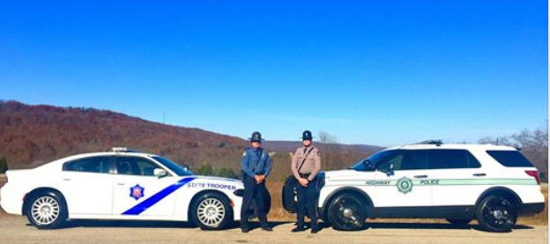
Regular Presence – ASP and AHP
Enforcement
  Reduced Work Zone Speed Limits
First responder to accidents
  Provide LEO perspective of situation
  Establish safe zone for additional first responders
Queue Assistance
  Secondary incident risk management
  Help mitigate incidents due to slowed traffic
Implement clear zone towing effort (not Wrecker Services; not ASP rotation)
Initiate emergency “slow roll”

Slide 34


